Slide 1
LINEAR ALGEBRA
Encryption and Decryption using
Determinat and Inverse Matrix
DECEMBER 14TH, 2020

Slide 2
INDEX
• Introduction
• Math
• Conclusion
•Team Members
• Related Works
• Algorithm & Result

Slide 3
TEAM MEMBERS
Kim Min Sung
Jun Geon Min
2017113356
KNU, CSE
2017116965
KNU, CSE

Slide 4


Introduction
Lets teach the computer how to whisper

Slide 5
Related Works
A. Enhancement outsourcing secruity
MDC
Ensure High Accuracy and Security
MMC
MIC
Also, using matrix operations performed well !

Slide 6
Related Works
B. Convolution Neural Network
Mathematical approach
Algorithms
Programming
In the STUDY, we implemented in C

Slide 7
MATH
A. Inverse of matrix
$$AA^{−1}=A^{−1}A=I_{n}$$
If we let the message matrix P..
$$PAA^{−1}=PA^{−1}A=P$$

Slide 8


MATH
B. Treating the determinant as constant
$$P=\left[\begin{matrix}1 & 1 & 1 \\ 1 & 1 & 1 \\ 1 & 1 & 1\end{matrix}\right]$$
If we let the Key matrix B..
$$P=\left[\begin{matrix}\left.1−\left|B\right|+|B\right| & \left.1−\left|B\right|+|B\right| & \left.1−\left|B\right|+|B\right| \\ \left.1−\left|B\right|+|B\right| & \left.1−\left|B\right|+|B\right| & \left.1−\left|B\right|+|B\right| \\ \left.1−\left|B\right|+|B\right| & \left.1−\left|B\right|+|B\right| & \left.1−\left|B\right|+|B\right|\end{matrix}\right]= \left[\begin{matrix}1 & 1 & 1 \\ 1 & 1 & 1 \\ 1 & 1 & 1\end{matrix}\right]$$

Slide 9
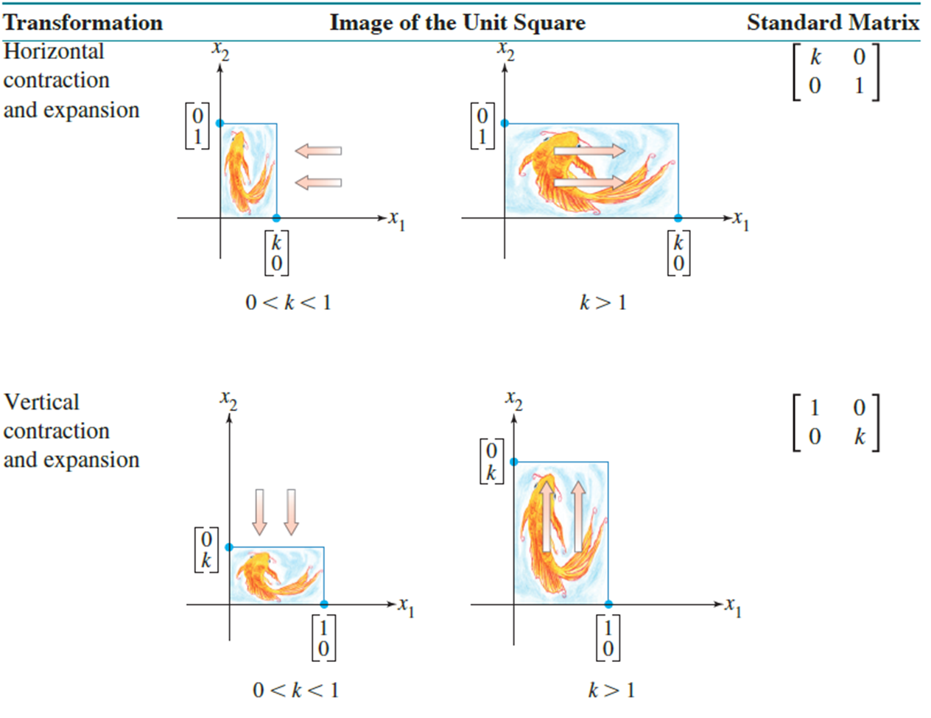
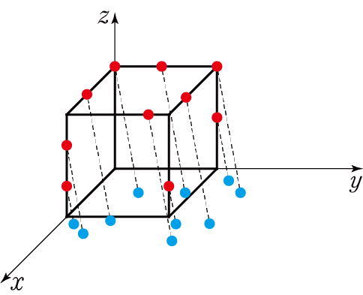
MATH
C. Coordinate transformation and parallel movement of matrix

Slide 10
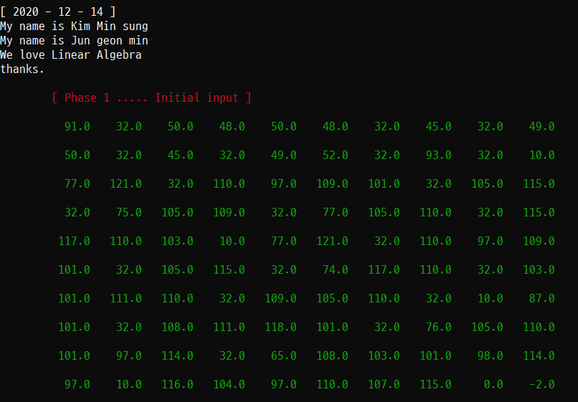
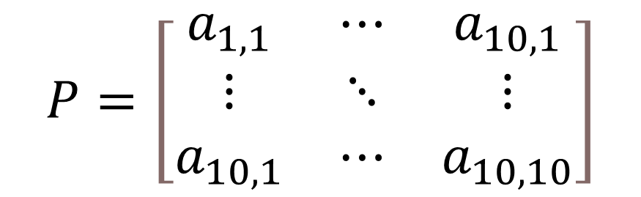
Algorithm & Result
Phase 1. Matrixing initial input mesaage
$$P=\left[\begin{matrix}a_{1,1} & ⋯ & a_{10,1} \\ ⋮ & ⋱ & ⋮ \\ a_{10,1} & ⋯ & a_{10,10}\end{matrix}\right]$$

Slide 11
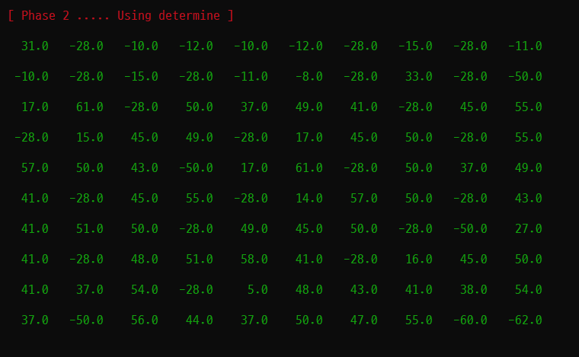
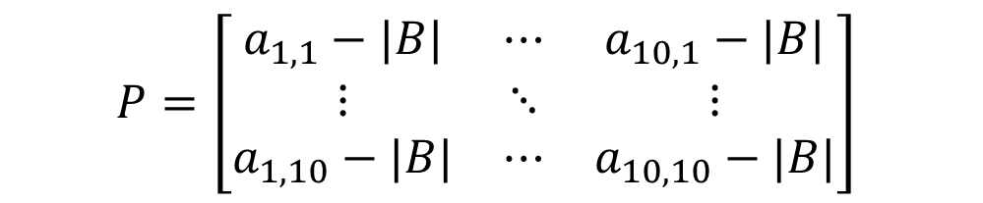
Algorithm & Result
Phase 2. Subracting determinant of key matrix B from each message matrix components
$$P=\left[\begin{matrix}a_{1,1}−|B| & ⋯ & a_{10,1}−|B| \\ ⋮ & ⋱ & ⋮ \\ a_{1,10}−|B| & ⋯ & a_{10,10}−|B|\end{matrix}\right]$$

Slide 12
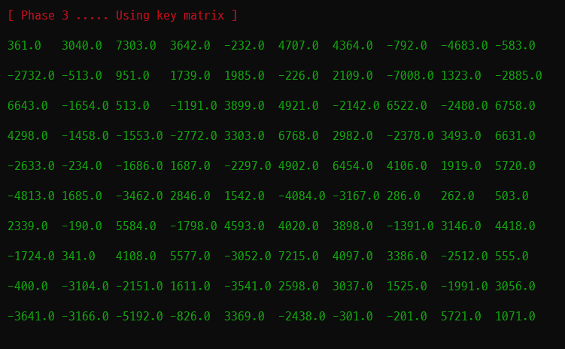
Algorithm & Result
Phase 3. Multiplying key matrix A to message matrix
$$PA$$

Slide 13
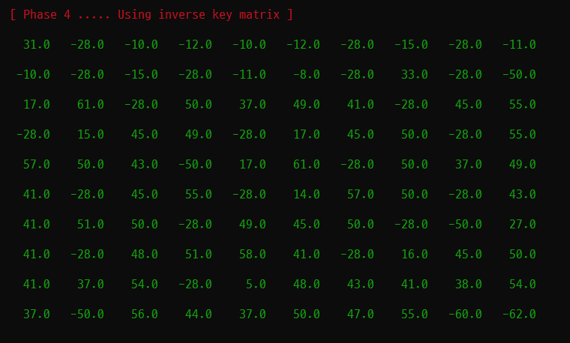
Algorithm & Result
Phase 4. Multiplying matrix $A^{−1}$ to message matrix
$$PAA^{−1}=P$$

Slide 14
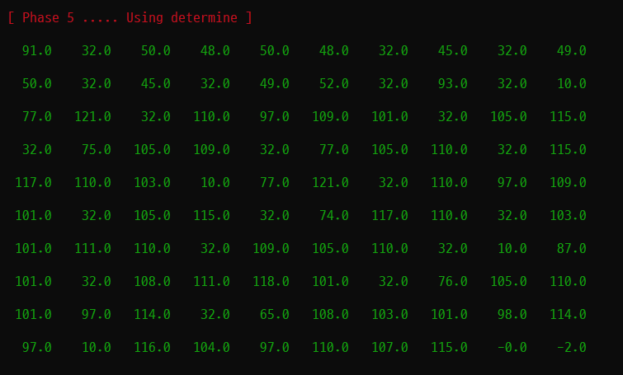
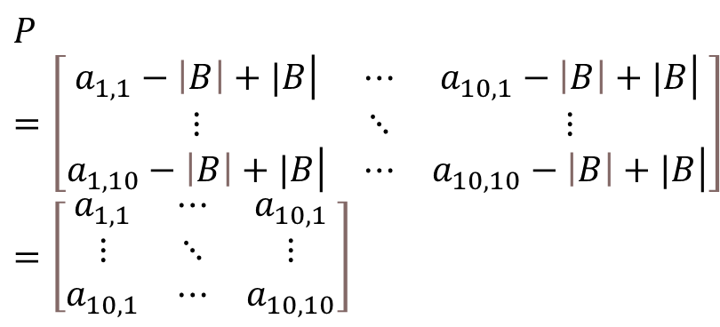
Algorithm & Result
Phase 5. Adding determinant of key matrix B to message matrix component
$$P=\left[\begin{matrix}\left.a_{1,1}−\left|B\right|+|B\right| & ⋯ & \left.a_{10,1}−\left|B\right|+|B\right| \\ ⋮ & ⋱ & ⋮ \\ \left.a_{1,10}−\left|B\right|+|B\right| & ⋯ & \left.a_{10,10}−\left|B\right|+|B\right|\end{matrix}\right]=\left[\begin{matrix}a_{1,1} & ⋯ & a_{10,1} \\ ⋮ & ⋱ & ⋮ \\ a_{10,1} & ⋯ & a_{10,10}\end{matrix}\right]$$

Slide 15
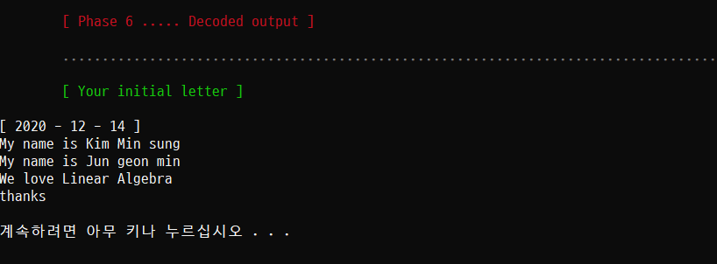
Algorithm & Result
Phase 6. Decoding initial input message

Slide 16

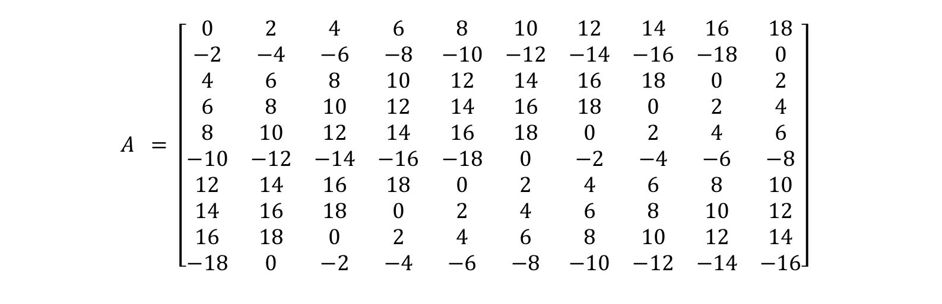
Algorithm & Result
The key matrix
$$A = \left[\begin{matrix}0 & 2 & 4 & 6 & 8 & 10 & 12 & 14 & 16 & 18 \\ −2 & −4 & −6 & −8 & −10 & −12 & −14 & −16 & −18 & 0 \\ 4 & 6 & 8 & 10 & 12 & 14 & 16 & 18 & 0 & 2 \\ 6 & 8 & 10 & 12 & 14 & 16 & 18 & 0 & 2 & 4 \\ 8 & 10 & 12 & 14 & 16 & 18 & 0 & 2 & 4 & 6 \\ −10 & −12 & −14 & −16 & −18 & 0 & −2 & −4 & −6 & −8 \\ 12 & 14 & 16 & 18 & 0 & 2 & 4 & 6 & 8 & 10 \\ 14 & 16 & 18 & 0 & 2 & 4 & 6 & 8 & 10 & 12 \\ 16 & 18 & 0 & 2 & 4 & 6 & 8 & 10 & 12 & 14 \\ −18 & 0 & −2 & −4 & −6 & −8 & −10 & −12 & −14 & −16\end{matrix}\right]$$
$$B= \left[\begin{matrix}1 & 3 & 5 \\ −5 & 3 & −1 \\ 3 & −1 & 5\end{matrix}\right]$$

Slide 17
Algorithm & Result
• Encryption message and decoding it performed well.
• There will be small challenge – The phase 3, 4.
• The message matrix must be n-by-n matrix which can contain at most n-by-n texts, and as the message become long, the key matrix must be large, too.
• So, the computer should compute the multiplying matrix process no matter how long the message and the key matrix. – This may require additional studies to overcome the difficulty by machine learning.

Slide 18
Conclusion
• In our study, we used fixed key matrices. But, if we apply a key generation algorithm when apply actual environment, security is enhanced as the number of cases increases.
• Also, there will be following potential security risks - When multiplying the inverse and then multiplying the original matrix again, the key matrix used in the inverse process is exposed.
• And when different matrices have the same determinant used during add and subtract process. So, the follow-up studies are required to prevent these problems.

